Slide 1
Moving day
A review of Toronto Neighborhoods
Author: Kiah Wenger
Date: 7/1/20

Slide 2
Clustering for decision making
Movers want to know what venues are in a neighborhood.
Entrepreneurs evaluate the number of similar venues in the area to determine how much competition they have.

Slide 3
Data
Location data Source –
(https://en.wikipedia.org/wiki/List_of_postal_codes_of_Canada:_M)
Neighborhood venue source – (Foursquare)

Slide 4
Methodology
Tools
Web API’s
Python Packages

Slide 5
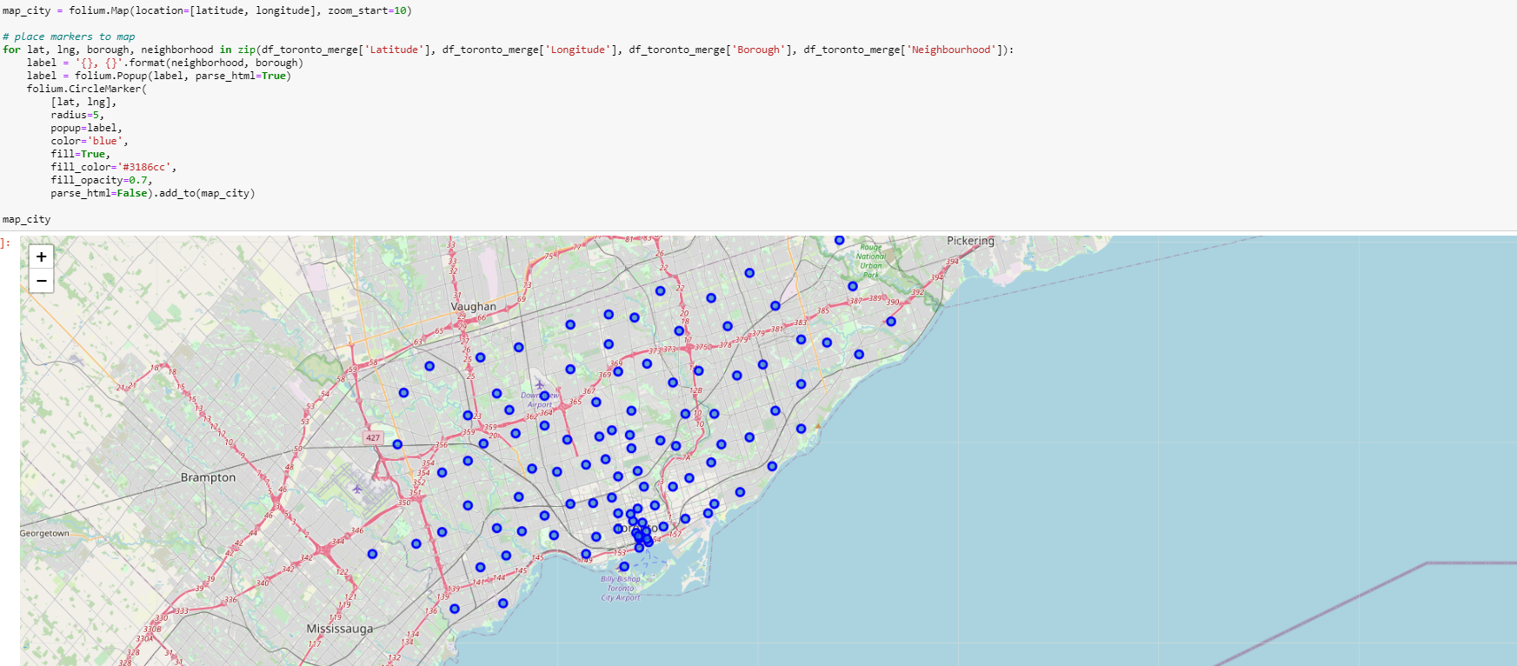
Implementation
We use Python Packages to create a map of all the neighborhoods.

Slide 6
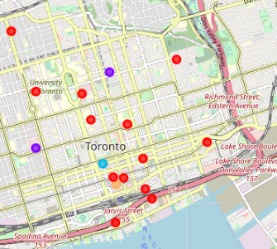
Implementation
The colored dots represent the various neighborhood clusters.

Slide 7
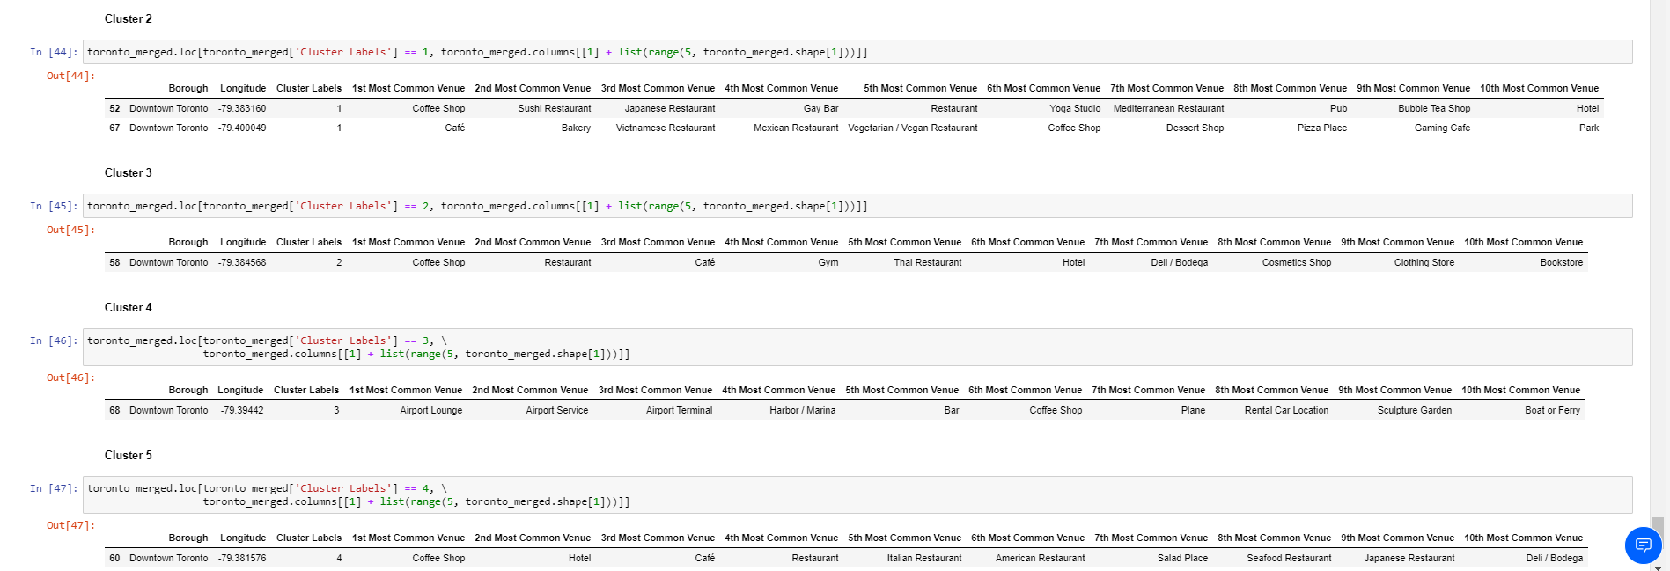
Implementation
Clusters 2, 3 & 5 have coffee shops as the most common venue
Cluster 4 has mostly airport related venues.

Slide 8
Conclusion
Cluster option layout will allow anyone moving to a new neighborhood to decide which area has the most venues desire.

